Slide 1
Battle of Neighborhoods
A short presentation on the evaluation of best neighborhoods in New York to migrate to, specific to the Indian community.
By,
Rajesh Wilson
B.Tech Computer Science

Slide 2
Background
Every year around 60000 plus Indias migrate to the US.
After Mexico and China, India was the third largest country of origin for new lawful permanent residents (LPRs) in FY 2015
Indians are highly educated (72%) with bachelor’s degrees or above compared to other U.S. Asians (51%) and General U.S. population (30%)
They have the highest median household income ($100k) among U.S. Asians ($73k) compared with general U.S. population ($53.6k)
Reason for this influx:
Economic prosperity
Educational facilities
Quality of life

Slide 3
Problem at hand
To address the conundrum of choosing a place to migrate, from the point of view of the Indian community, we shall at an example of New York for now.
Some of the factors affecting the choice of place to migrate to:
Presence of a community of the same kind.
Real estate / Rental prices
Proximity to educational institutions
Hospitals and Clinics
Crime rate
Proximity to restaurants, grocery stores, entertainment zones, etc.
We shall be looking at a sub-set of these factors to determine the best neighborhoods in New York to migrate to.

Slide 4
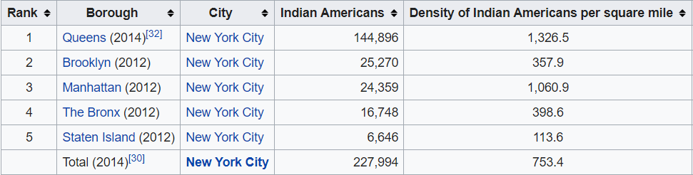
Data used
1. Population density of Indian-Americans in New York
The above table was scraped from a Wikipedia page and Queens was selected for further evaluation since it had the highest density.
Only one borough was selected for the sake of simplicity.
Source: https://en.wikipedia.org/wiki/Indians_in_the_New_York_City_metropolitan_region

Slide 5
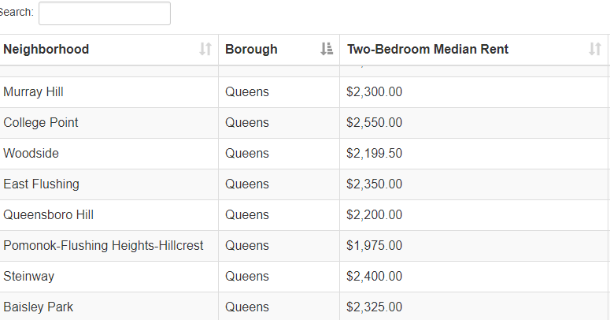
..Data used
2. Home rental rates
Median home rental rates were scraped from www.renthop.com for Queens borough
The data was sorted and top 10 neighborhoods were selected for further evaluation.
Source: https://www.renthop.com/study/assets/new-york-city-cost-of-living-2017/nyc-2br-median-rent-and-income-table.html

Slide 6
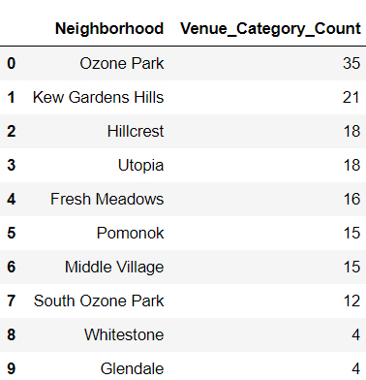
..Data used
3. Venues around Queens neighborhood
Foursquare api was used to explore the venues around the top 10 neighborhoods scraped from the previous data table.
Due to the limited potential of Foursquare only the count of category of venues was considered for evaluation. Higher the number of venue categories, better the location.

Slide 7
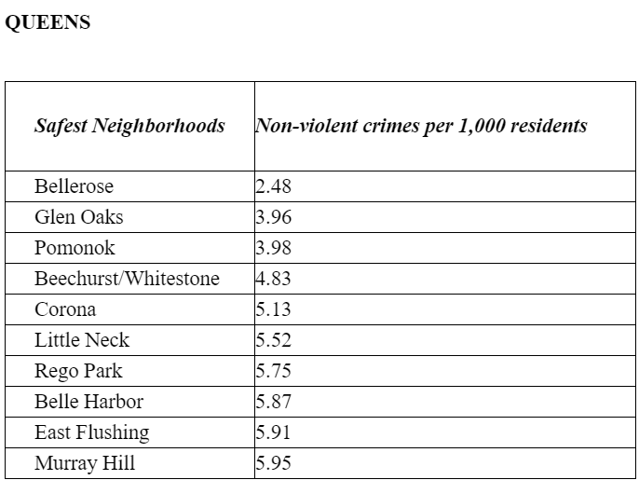
..Data used
4. Crime rate
Crime data with respect to Queens neighborhoods was scraped from the following source:
https://www.brickunderground.com/blog/2014/07/address_report_safest_and_least_safe_neighborhoods
Since the data available was limited, top 5 neighborhoods were chosen for the final evaluation.

Slide 8
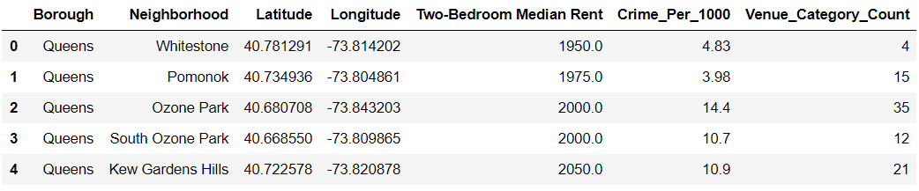
Data Merge
Finally, all relevant data was merged to form a single data-frame depicting rental rates, crime rate, and venue category counts of the top 5 neighborhoods in Queens

Slide 9
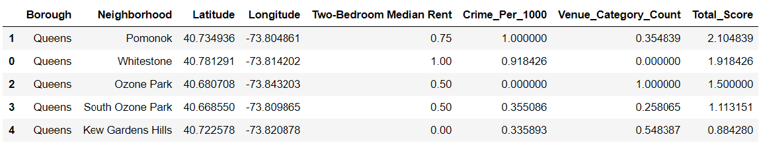
Scoring and Sorting
The MinMaxScaler from sklearn.preprocessing was used to normalize the values of rental rates, crime rate and venue categories.
Normalized values of rental rates and crime rate had to be deducted from 1 to represent the true score, since lower crime rate/rent rate should hold higher score.
Finally, all individual values were added to arrive at final score, which was sorted to display the top 5 neighborhoods.

Slide 10
Conclusion
From the final score it can be implied that Pomonok can be considered a good place to migrate since it has the right blend of lower crime and rental rates and popular for the venues around it.
This was a very crude method to evaluate the criteria to move to a place based on very limited factors.
The factors could not be expanded due to the limited potential of Foursquare API to correctly identify venues that could potentially affect ones choice of place, like proximity to Hospitals, Schools, Libraries, etc., with far more advanced way of scoringand ranking places based on these factors.

Slide 11
Sources
https://www.migrationpolicy.org/article/indian-immigrants-united-states
https://en.wikipedia.org/wiki/Immigration_to_the_United_States
https://www.brookings.edu/wp-content/uploads/2018/01/indian-migration-to-the-us.pdf
https://www8.gsb.columbia.edu/articles/chazen-global-insights/singular-population-indian-immigrants-america
https://en.wikipedia.org/wiki/Indians_in_the_New_York_City_metropolitan_region
https://www.renthop.com/study/assets/new-york-city-cost-of-living-2017/nyc-2br-median-rent-and-income-table.html
https://www.brickunderground.com/blog/2014/07/address_report_safest_and_least_safe_neighborhoods

